Slide 1

Computer Graphics
Dr. Lucy J. Gudino
Computer Science & Information Systems Group
Birla Institute of Technology & Science, Pilani, Goa Campus

Slide 2
Clipping and Polygon filling

Slide 3
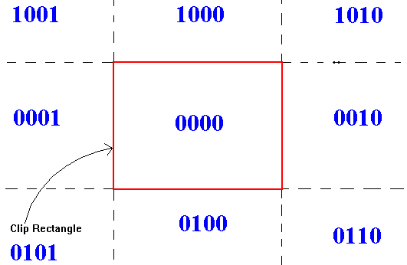
Algorithm
if (EC1 == EC2 == 0000)
accept the line
if ((EC1 & EC2) != 0)
reject the line
Else clip the line against an edge (where bits are nonzero)
Assign the new vertex a 4-bit value
Return to 1
Note: EC is end code

Slide 4
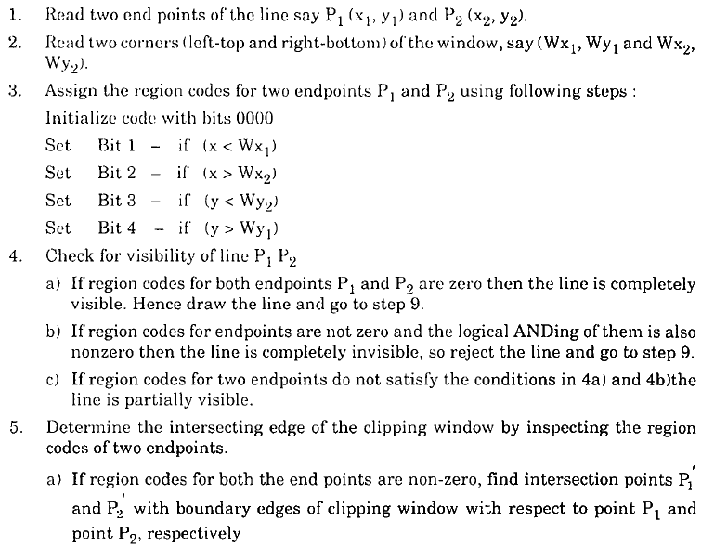
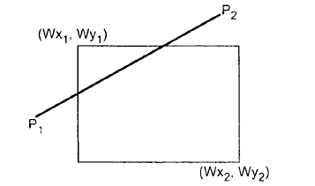
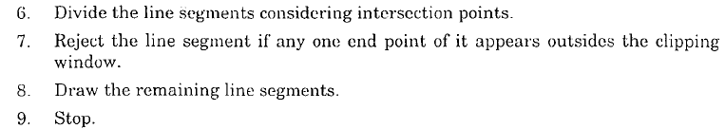

Slide 5

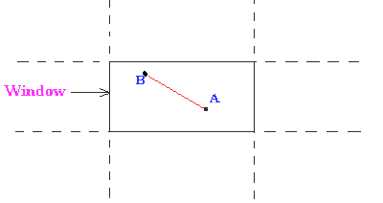

Example 1
Out Code for point P1 | Out Code for point P2 | “AND” | Remarks
0000 | 0000 | N/A | Fully visible, retain

Slide 6
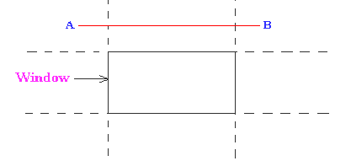
Example 2
Out Code for point P1 | Out Code for point P2 | “AND” | Remarks
NON ZERO | NON ZERO | NON ZERO | Completely outside window, corresponding to the edge with out code bit 1. Fully invisible➔ Reject

Slide 7
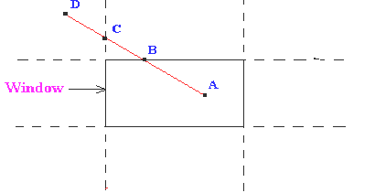
Example 3
Out Code for point P1 | Out Code for point P2 | “AND” | Remarks
0000 | NON ZERO | N/A or ANDing yields Zero | Partly visible; crosses from window to surrounding region corresponding to the 1 bits. Needs Clipping
NON ZERO | 0000
Notes:
Point A has an outcode of 0000 and point D has an outcode of 1001. The logical AND of these outcodes is zero; therefore, the line cannot be trivally rejected. Also, the logical OR of the outcodes is not zero; therefore, the line cannot be trivally accepted. The algorithm then chooses D as the outside point (its outcode contains 1's). By our testing order, we first use the top edge to clip AD at B. The algorithm then recomputes B's outcode as 0000. With the next iteration of the algorithm, AB is tested and is trivially accepted and displayed.

Slide 8
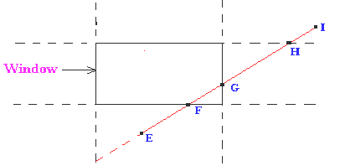
Example 4
Out Code for point P1 | Out Code for point P2 | “AND” | Remarks
NON ZERO | NON ZERO | ZERO | Cannot decide; needs further investigation of the line segments
Notes:
Point E has an outcode of 0100, while point I's outcode is 1010. The results of the trivial tests show that the line can neither be trivally rejected or accepted. Point E is determined to be an outside point, so the algorithm clips the line against the bottom edge of the window. Now line EI has been clipped to be line FI. Line FI is tested and cannot be trivially accepted or rejected. Point F has an outcode of 0000, so the algorithm chooses point I as an outside point since its outcode is1010. The line FI is clipped against the window's top edge, yielding a new line FH. Line FH cannot be trivally accepted or rejected. Since H's outcode is 0010, the next iteration of the algorthm clips against the window's right edge, yielding line FG. The next iteration of the algorithm tests FG, and it is trivially accepted and display

Slide 9
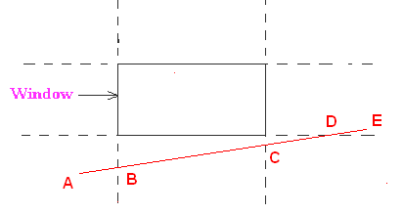
Example 5

Slide 10
Contd…
Case | Out Code for point P1 | Out Code for point P2 | “AND” | Remarks
1 | 0000 | 0000 | N/A | Fully visible, retain
2(a) | 0000 | NON ZERO | N/A | Partly visible; crosses from window to surrounding region corresponding to the 1 bits. Needs Clipping
2(b) | NON ZERO | 0000
3 | NON ZERO | NON ZERO | NON ZERO | Completely outside window, corresponding to the edge with out code bit 1. Fully invisible➔ Reject
4 | NON ZERO | NON ZERO | ZERO | Cannot decide; needs further investigation of the line segments

Slide 11
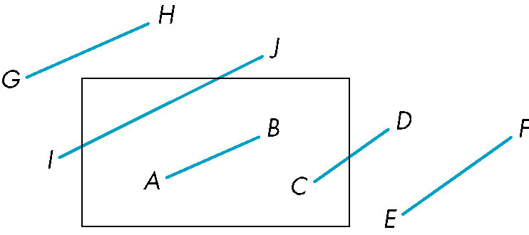
Cohen-Sutherland Example
What are the vertex codes for these lines?
Notes:
G = 1001, H = 1000 (REJECT); I = 0001, J = 1000 (CLIP)
A = 0000, B = 0000 (ACCEPT); C = 0000, B = 0010 (CLIP)
E = 0100, F = 0100 (REJECT)

Slide 12
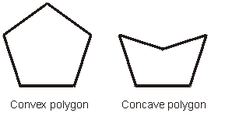
Polygon Clipping
Polygon Clipping:
  Collection of lines
  is an area primitive
  Simple Polygon
    Planar set of ordered points
    No line crossings
    No holes
  Convex and non-convex polygon(concave)

Slide 13
Polygon Clipping
Convex polygon
  Every internal angle is less than or equal to 180 degrees.
  Every line segment between two vertices remains inside or on the boundary of the polygon.
Concave polygon
  will always have an interior angle with a measure that is greater than 180 degrees.

Slide 14
Polygon Clipping
Sutherland-Hodgman algorithm (A divide-and-conquer strategy)
  Window must be convex
  Polygon to be clipped can be convex or non-convex

Slide 15
Polygon Clipping
Sutherland-Hodgeman algorithm (A divide-and-conquer strategy)
    Polygons can be clipped against each edge of the window one at a time. Edge intersections, if any, are easy to find since the X or Y coordinates are already known.
    Vertices which are kept after clipping against one window edge are saved for clipping against the remaining edges.
    Note that the number of vertices usually changes and will often increases.

Slide 16
Polygon Clipping
v1
v1’
v1”
v3’
v3
v3”
v2
v2

Slide 17
Polygon Clipping
Right Clip Boundary
Bottom Clip Boundary
Top Clip Boundary
Left Clip Boundary

Slide 18
Sutherland-Hodgman
Polygon Clipping
Input each edge (vertex pair) successively.
Output is a new list of vertices.
Each edge goes through 4 clippers.
The rule for each edge for each clipper is:
  If first input vertex is outside, and second is inside, output the intersection and the second vertex
  If both input vertices are inside, then just output second vertex
  If first input vertex is inside, and second is outside, output is the intersection
  If both vertices are outside, output is nothing

Slide 19
Sutherland-Hodgman Polygon Clipping:
Four possible scenarios at each clipper
outside inside
outside inside
outside inside
outside inside
v2
v2
v2
v2
v1’
v1’
v1
v1
v1
v1
Outside to inside:
Output: v1’ and v2
Inside to inside:
Output: v2
Inside to outside:
Output: v1’
Outside to outside:
Output: nothing

Slide 20
An Example for the Polygon Clipping
v₅
v₄
v₁
v₂
v₃

Slide 21
Solution:
outside inside
outside inside
outside inside
outside inside
v2
v2
v2
v2
v1’
v1’
v1
v1
v1
v1
Outside to inside:
Output: v1’ and v2
Inside to inside:
Output: v2
Inside to outside:
Output: v1’
Outside to outside:
Output: nothing
v₅
v₅
v₄
v₁
v₁
v₁
v₂
v₃
Clipping edge
Clipping edge
Clipping edge

Slide 22
outside inside
outside inside
outside inside
outside inside
v2
v2
v2
v2
v1’
v1’
v1
v1
v1
v1
Outside to inside:
Output: v1’ and v2
Inside to inside:
Output: v2
Inside to outside:
Output: v1’
Outside to outside:
Output: nothing
Now v₁v₂:
v₅
v₄
v₁
v₁
v₁
v₂
v₃
v₂
v₂
Clipping edge
Clipping edge
Clipping edge

Slide 23
outside inside
outside inside
outside inside
outside inside
v2
v2
v2
v2
v1’
v1’
v1
v1
v1
v1
Outside to inside:
Output: v1’ and v2
Inside to inside:
Output: v2
Inside to outside:
Output: v1’
Outside to outside:
Output: nothing
Now v₂v₃:
v₅
v₄
v₁
v₁
v₂
v₃
v₂
v₃
v₂
v₃
v₂
Clipping edge
Clipping edge
Clipping edge

Slide 24
outside inside
outside inside
outside inside
outside inside
v2
v2
v2
v2
v1’
v1’
v1
v1
v1
v1
Outside to inside:
Output: v1’ and v2
Inside to inside:
Output: v2
Inside to outside:
Output: v1’
Outside to outside:
Output: nothing
Now v₃v₄:
v₅
v₄
v₄
v₁
v₁
V3’
v₂
v₃
v₂
v₃
v₃
v₂
Clipping edge
Clipping edge
Clipping edge

Slide 25
outside inside
outside inside
outside inside
outside inside
v2
v2
v2
v2
v1’
v1’
v1
v1
v1
v1
Outside to inside:
Output: v1’ and v2
Inside to inside:
Output: v2
Inside to outside:
Output: v1’
Outside to outside:
Output: nothing
Now v₄v₅:
v₅
v₅
v₅
v₄
v₄
V4’
v₁
v₁
V3’
v₂
v₃
v₂
v₃
v₂
Clipping edge
Clipping edge
Clipping edge
After these, we have to clip the polygon against the other three edges of the window in a similar way.

Slide 26
Sutherland-Hodgman Polygon Clipping
v2’
v2
v3
v1’
v3’
Left
Clipper
Right
Clipper
Bottom
Clipper
Top
Clipper
v1
v1v2
v2
v2v2’
v2’
v2’v3’
v2”
v2”v1’
v1’
v2v3
v2’
v2’v3’
v3’
v3’v1
v1’v2
v2
v3v1
v3’v1
v3’v1
v1
v1v2
v1’v2
v2v2’
v2’
v1v2
v2
v2v2’
v2’
v2’v2”
v2”
Edges Output
Edges Output
Edges Output
Edges Output
Final

